Slide 1
Measuring Transit Accessibility

Slide 2
Agenda
Introductions
Overview of R at King County Metro
Two case studies:
Transit accessibility
Rider/Non-Rider Survey Analysis
Questions/Answers
Notes:
This may change. Planning to do introductions, frame the talk as one about why R/programming generally is useful in transit planning. Iteration, improvement, integration. Introduce case studies. Acknowledge that R is used on many other projects.

Slide 3

R at King County Metro
Au: Allison Horst
Notes:
Data science is evolving at KCM. We are building skills and internal support for rigorous analysis and the use of coding tools in our workflows. No one has a background in CS, so we take a “learn and teach on the job” approach to building a DS culture.

Slide 4
Transit Accessibility
Transit Accessibility: How many places someone can get to using transit in a certain amount of time from their starting location.
Part of Metro’s Strategic Plan
Important for measuring how well transit meets people’s needs
Notes:
One of the many ways where we use R and our community of support is our accessibility analysis. Before diving in to how we do our analysis, I want to make sure that everyone knows what I mean when I’m talking about accessibility and why it’s an important part of transit planning.

Slide 5

Transit Accessibility
Au: Jarrett Walker Associates

Slide 6

Transit Accessibility
Au: Jarrett Walker Associates

Slide 7
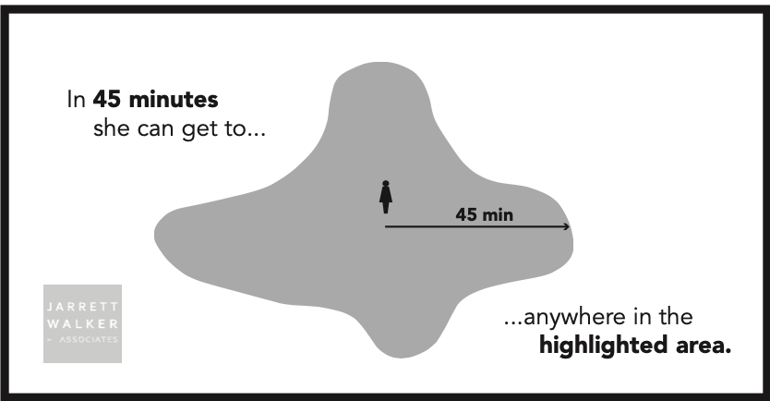
Transit Accessibility
Au: Jarrett Walker Associates

Slide 8
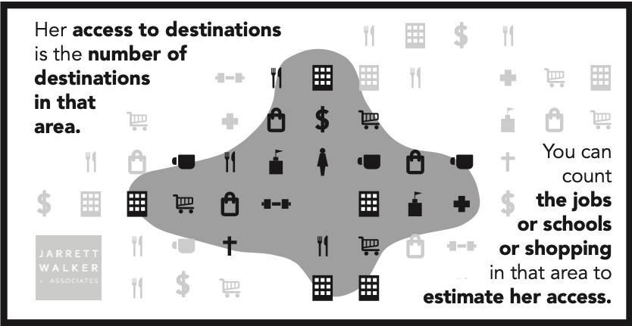
Transit Accessibility
Au: Jarrett Walker Associates
Notes:
Accessibility is important to measure because it can determine how much of a person’s travel needs can be completed on an existing or planned transit network. Metro’s strategic plan calls for annual measurements in the change in county-wide transit accessibility.
At a theoretical level, accessibility is very simple. However, the process of measuring transit accessibility requires iteration. This is where R plays a critical role, as traditional transit planning tools require planners to manually select analysis locations, which is not possible at a county-wide scale.

Slide 9

r5R to the Rescue!
r5R is a network based routing tool that allows analysts to model time-based travel for different modes of transportation.
Notes:
r5R is a network based routing tool that uses a java backend, the Open Street Map Network and the GTFS to allow analysts to model time-based travel for different modes of transportation. Allows for use of different decay functions ( a quick trip to a destination is worth more than a long trip).

Slide 10
A quick look at r5r
Requires:
Open Street Map network file
Origin and destination points
General Transit Feed Specifications (GTFS)
Works well with the purrr library
Implements decay curves to model how people perceive opportunities (a quick trip to a destination is worth more than a long trip).
Full documentation available here

Slide 11
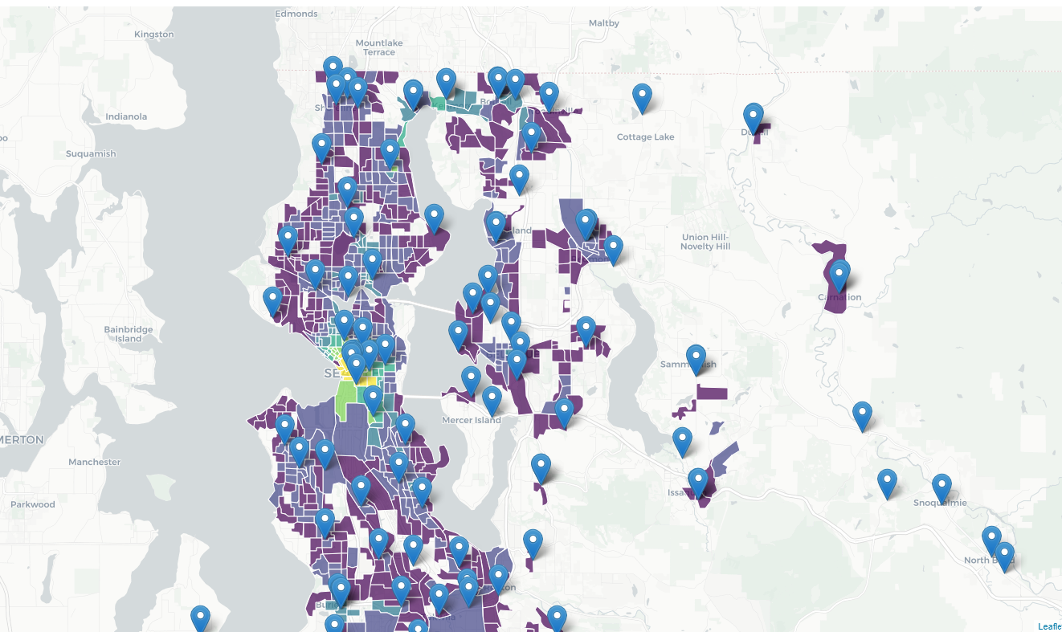
r5r at King County
Community Assets Database for destinations
Calculated using a quarter mile hexagon map, then aggregated using population weighted interpolation

Slide 12
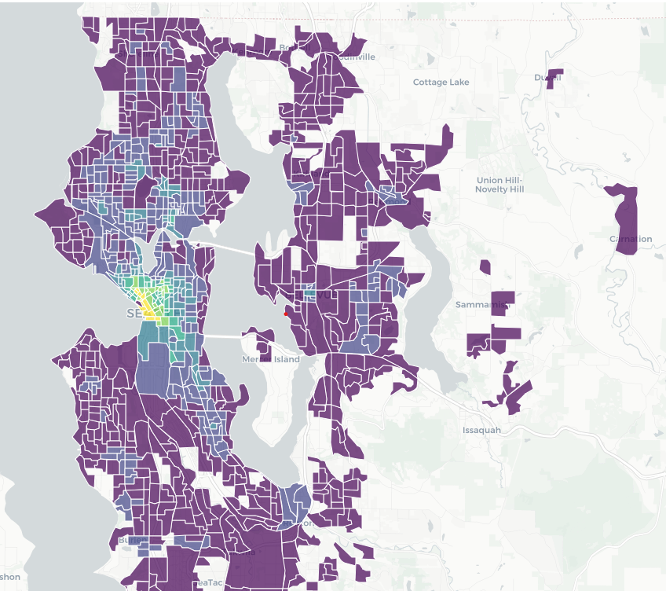
Time for a demo!
Models a 30 minute walking & transit trip at noon on a weekday during Spring 2022.
Access to different types of destinations calculated separately

Slide 13
r5r Accessibility Function
ttm <- accessibility(r5r_core = r5r_core, decay_function = "logistic", origins = origins, destinations = dest_hex_points, opportunities_colname = c("grocery", "public_spaces"), mode = c("WALK", "TRANSIT"), departure_datetime = as.POSIXct(departure_datetime, format = "%d-%m-%Y %H:%M:%S"), max_walk_time = 10, time_window = 5L, max_trip_duration = 45, verbose = F, decay_value = 15, cutoffs = 30)

Slide 14
Block Group Interpolation
interpolated_bg_access <- ttm %>% select(-rowid) %>% interpolate_pw(to = block_groups, to_id = "GEO_ID_GRP", weights = blocks, weight_column = "POP20", crs = 2926, extensive = FALSE, weight_placement = "surface")

Slide 15
Creating Accessibility Metrics

Slide 16
Strategic Targets & Metric Development
Strategic Plan
Guiding Principles
Equity Cabinet
Regional Transit Task Force
Service Guidelines Task Force
Objectives
Strategies
Measures
Equitable and Fair
Financially sustainable
Regionally collaborative
Quality local government
Notes:
Led by guiding principles of Metro set forth in Mobility Framework
Informed by Equity Cabinet
RTC
SG TF
Objectives

Slide 17
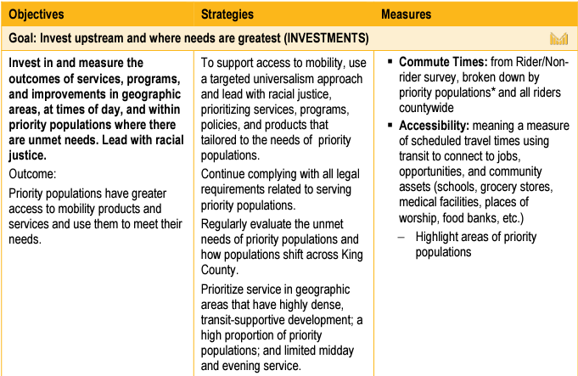
From ‘Measures’ to Metrics
Evaluate Existing Metrics
Metro Staff Brainstorm and Test New Analysis
Engage with Community & Policy Makers
Adjust and Modify
Visualize
Engage with Community & Policy Makers

Slide 18
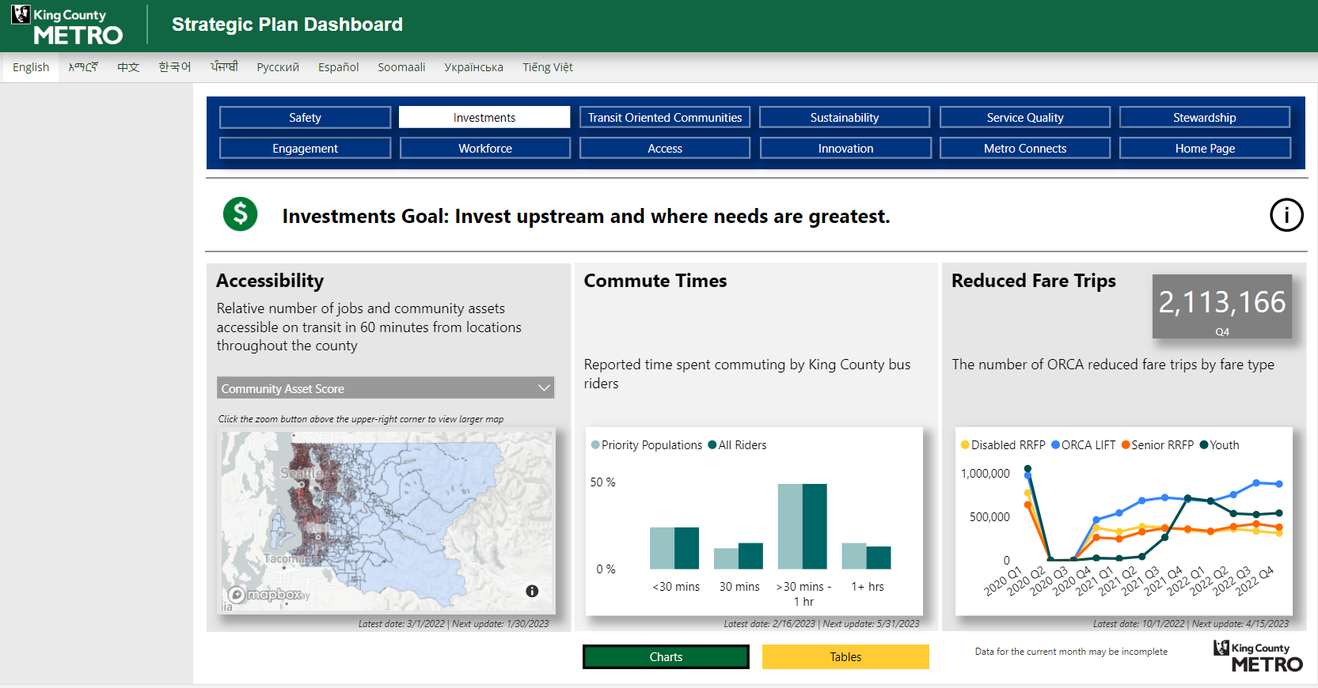
Strategic Plan Dashboard

Slide 19
Group Community Assets
Assistance
Work-source centers, food banks, ORCA LIFT, Senior Centers, WIC Vendors, Disability Assistance
Election Drop Boxes
Grocery
Farmer’s markets, grocery stores
Health & Wellness
Fed. Qualified health centers, hospitals, WIC Clinics, Residential treatment
ORCA Fare Outlets
Public Spaces
Libraries, community centers, places of worship
K-12 Education
Secondary Education
Colleges & universities, apprenticeship programs
Shopping Centers

Slide 20
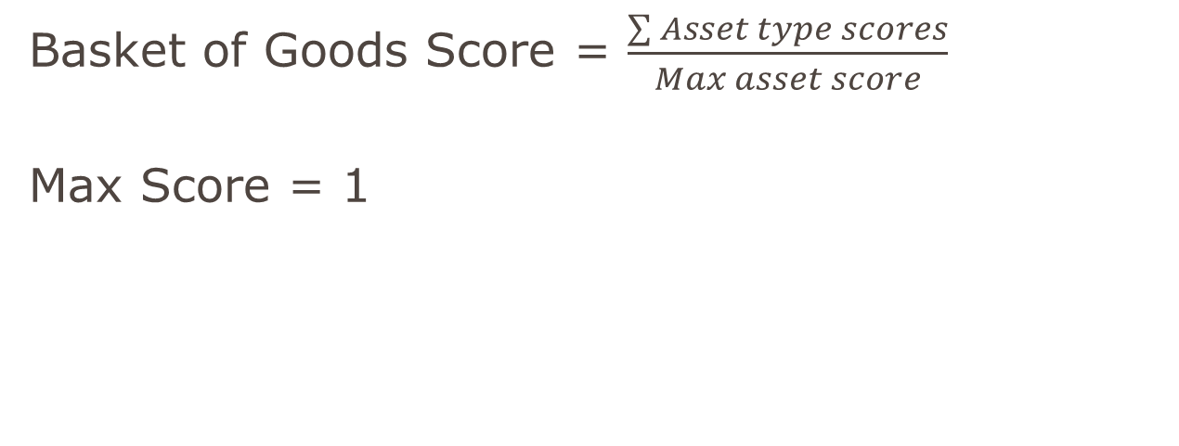
‘Basket of Goods’ Scoring Final ‘Basket of Goods’ Scoring
Basket of Goods Score = $\frac{\sum{Asset type scores}}{Max asset score}$
Max Score = 1

Slide 21
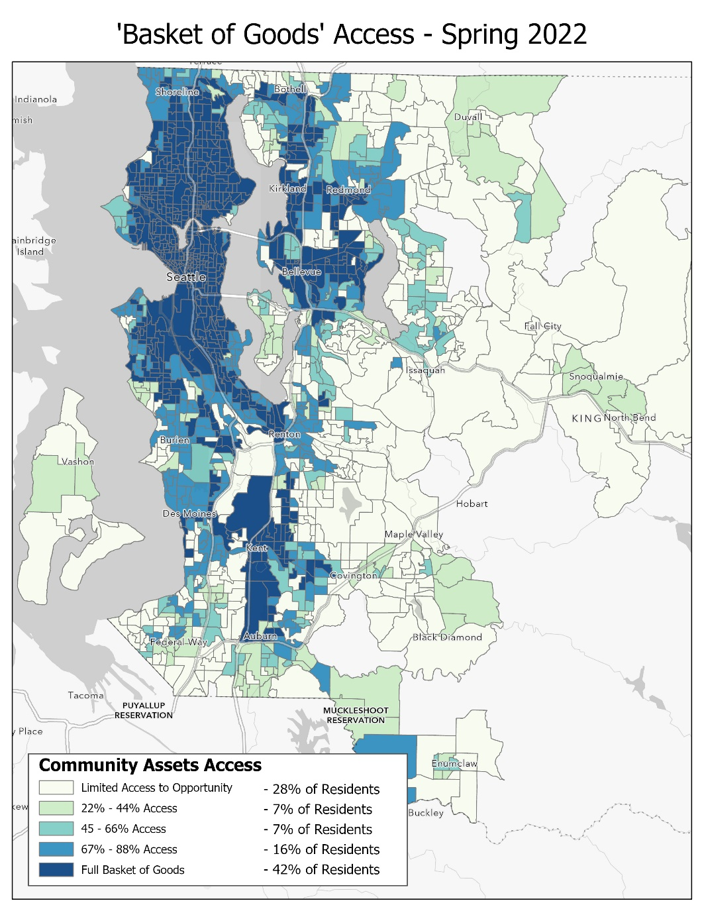
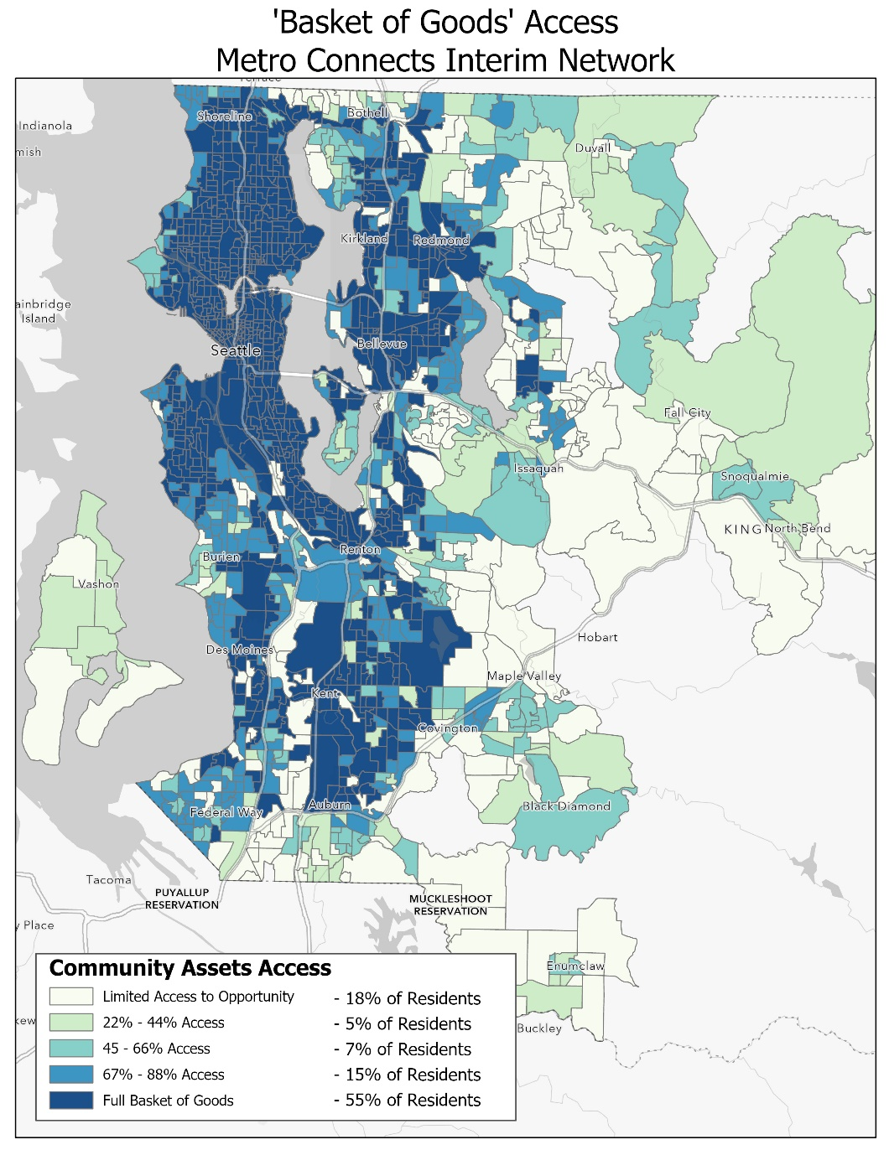
‘Basket of Goods’ Scoring

Slide 22
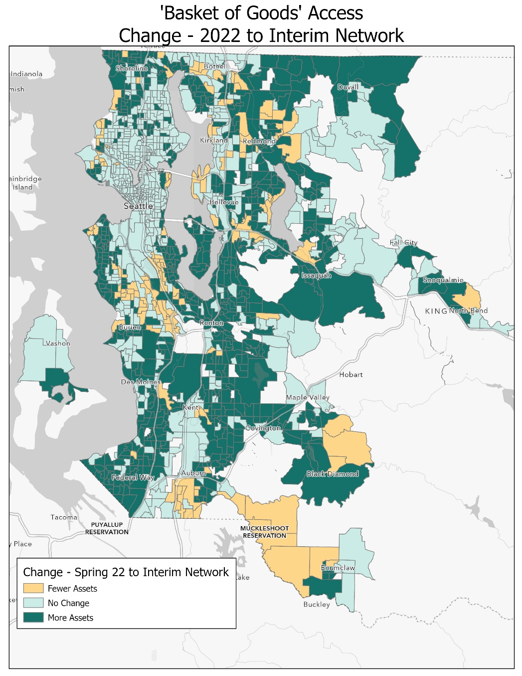
‘Basket of Goods’ Scoring

Slide 23
Social Science and Survey Research using R at King County Metro

Slide 24
Research Team’s Uses of R
Cleaning and manipulation
Quantitative analysis
Qualitative/text analysis

Slide 25

Importing, examining data
Working with survey data often means that you’re working with data collected via a survey platform, like Qualtrics
Requires logging into survey platform, exporting data to a folder in file format of your choice
Not very efficient – ensuring you have the latest version, working with data before data collection is complete, shared folders with others, etc.
Fortunately, packages like ‘qualtRics’ exist
Using API token, you can fetch data making the cleaning process seamless

Slide 26
Example API Connection and Pull
library(qualtRics) qualtrics_api_credentials(api_key = "yourkeygoeshere", base_url ="yourbaseurl.comgoeshere", install = TRUE)
#Once this connection is made, you don't need to do it again. You can just read in readRenviron("~/.Renviron")
#Need to identify what survey you're working with, pops up as a data frame with a list of all surveys and their characteristics surveylist<-all_surveys() #Call in specific survey of interest data <- fetch_survey(surveyID = surveylist$id[10], verbose=TRUE, force_request=TRUE,
convert=FALSE, label = FALSE, unanswer_recode_multi = 0)

Slide 27

Use R to clean and manipulate data
Survey collection platforms often offer the ability to pre-process data before you even collect it
Such as renaming variables, coding how you would like answer options to export, etc.
Nevertheless – not everything gets exported in the way that makes it easiest to use
Creating factor variables from multiple-select responses
Aggregating some factor variables into versions with less levels, due to distribution of responses
Generally making things more intelligible and easy to use

Slide 28
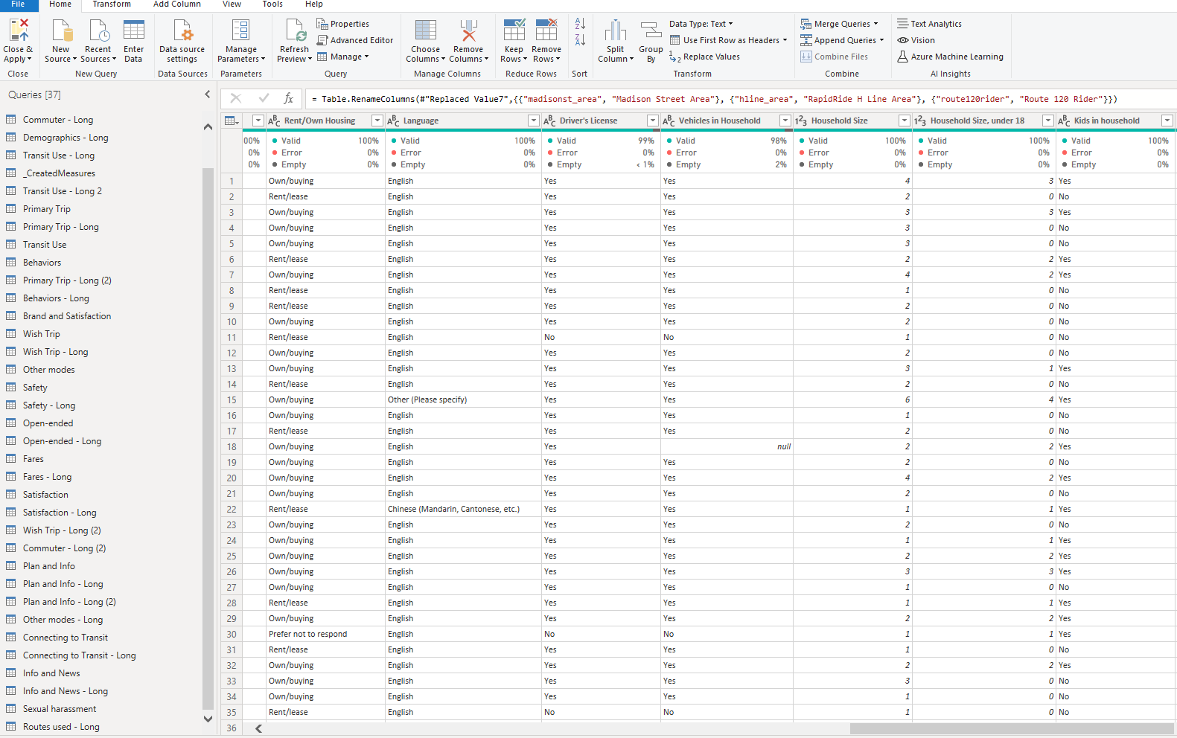
R to Power BI
King County Metro relies heavily on Microsoft’s Power BI
Power BI is not the easiest to work with, uses point and click or very clunky syntax for data manipulation
Using R allows for a workflow that is easy to replicate and minimizes the need to rely on doing work in Power BI
Notes:
King County Metro relies heavily on Power BI as a data visualization tool, but Power BI offers limited or clunky ways of manipulating data Particularly when trying to work with data that refresh regularly – applying the same steps to the data every time and changing syntax when needed is MUCH easier than working through point-and-click nature of Power BI

Slide 29
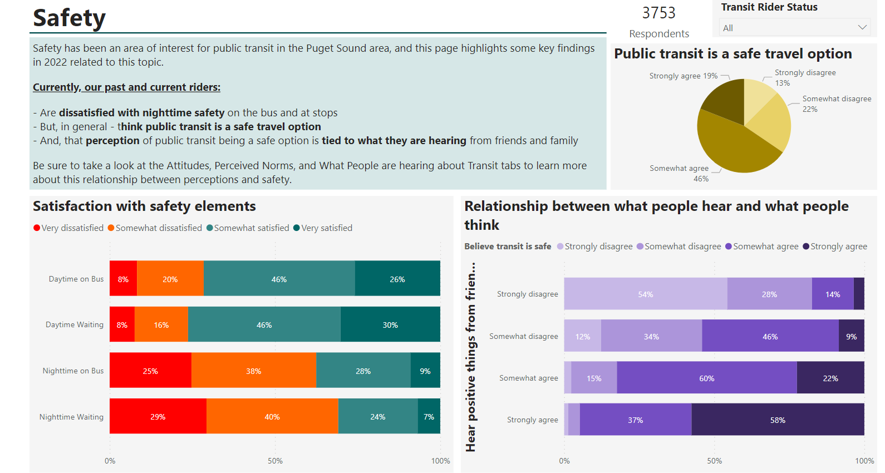
Analysis in R to complement data viz in Power BI
Limitations also exist in Power BI’s ability to execute statistical analysis
Use R to identify statistically significant differences across groups, generalized linear modeling, marginal effects for interaction terms
Analyses in R then supplement Power BI dashboard with narrative write-ups to help aid in the use and interpretation of survey data
Notes:
Great data visualization tool, but are differences across groups meaningful or statistical noise?

Slide 30
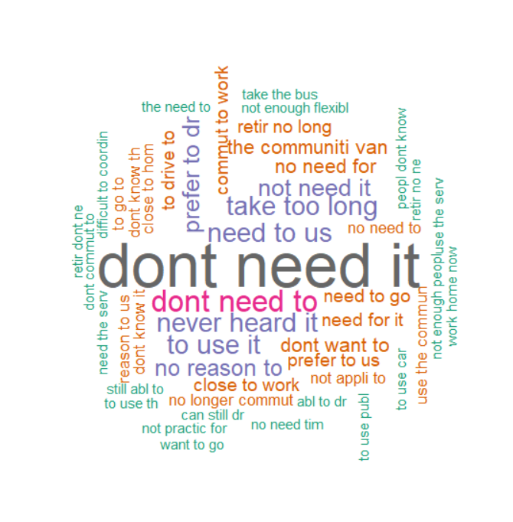
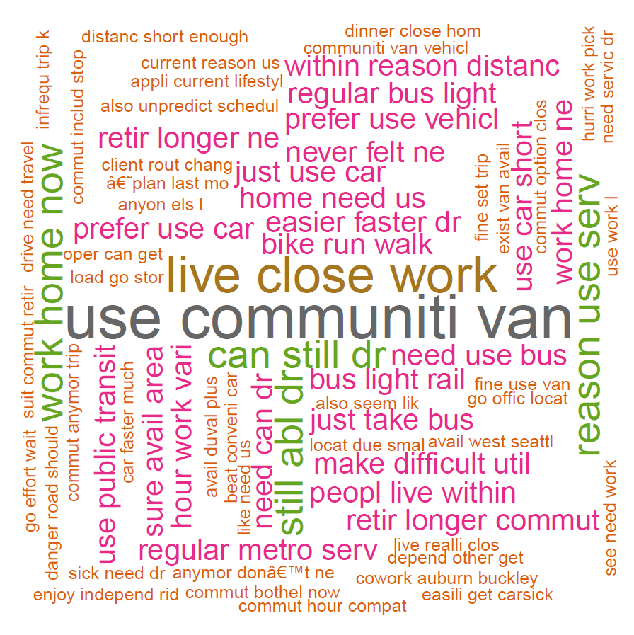
Text Analysis and Structural Topic Modeling
Use R packages for first looks at responses to open-ended survey questions
‘quanteda’
‘topicmodels’
‘stm’
‘NLTK’
‘wordcloud’

Slide 31
Structural Topic Modeling
Use to take a quick look at some of the common themes that appear in open-ended, in addition to most common n-grams and phrases
PROB: Words that have the highest probability of appearing in a given topic
FREX: Words that are both frequent and exclusive, identifying words that distinguish topics
Topic 1 Top Words:
Highest Prob: dont, use, bus, commut, servic, never, schedul
FREX: use, never, schedul, dont, commut, regular, current
Topic 2 Top Words:
Highest Prob: inconveni, match, complic, consist, situat, provid
FREX: inconveni, answer, match, complic, consist, situat
Topic 3 Top Words:
Highest Prob: servic, like, previous, last, just, tri, plan
FREX: last, servic, like, previous, tri, adequ, just

Slide 32
Thank you! Questions, comments?

